Slide 1
EPON

Slide 2
EPON
First/last mile
  Access networks connect business & residential subscribers to COs of service providers
  Access networks are commonly referred to as first mile or last mile
  Conventional access network technologies
    Digital subscriber line (xDSL)
    Cable modem
    Hybrid fiber coax (HFC) systems
  Future access solution requirements
    Provide more bandwidth than HFC systems for emerging services & applications (e.g., video on demand, IPTV, gaming)
    Meet cost-sensitivity constraints due to small number of cost-sharing subscribers

Slide 3
EPON
FTTX
  FTTX networks replace copper-based distribution part of HFC access networks with optical fiber => significantly increased capacity to provide broadband services
  FTTX networks bring fiber close or all the way to subscribers
  Examples
    Fiber to the node/neighborhood (FTTN)
    Fiber to the curb (FTTC)
    Fiber to the building (FTTB)
    Fiber to the home (FTTH)
  Due to cost sensitivity of access networks, FTTX networks are typically unpowered => passive optical networks (PONs)

Slide 4
EPON
PONs
  PONs had attracted much attention well before Internet spurred bandwidth growth
  Full service access network (FSAN) group
    ITU-T G.983 broadband PON (BPON)
      ATM as native protocol data unit (PDU)
      ATM suffers from several shortcomings (e.g., cell tax overhead, costly ATM switches & NICs)
  Recently, Ethernet PONs (EPONs) have been receiving increasing amount of interest both in industry & academia
  Several fora & working groups formed to promote EPONs
    EPON forum
    Ethernet in the first mile (EFM) alliance
    IEEE 802.3ah working group

Slide 5
EPON
EPON
  EPON carries data encapsulated in Ethernet frames
    => Capability of natively carrying IP packets
    => Interoperability with installed Ethernet LANs
  EPON combines low-cost Ethernet equipment (switches, NICs) & low-cost PON fiber infrastructure
  EPON appears natural candidate for future first-mile solutions due to the fact that >90% of today’s data traffic originates from & terminates in Ethernet LANs
  IEEE 802.3ah Task Force
    Standardized multipoint control protocol (MPCP)
    MPCP facilitates dynamic bandwidth allocation (DBA) in upstream direction
    DBA capitalizes on statistical multiplexing of bursty traffic
    Design of DBA algorithms is key, but not part of IEEE 802.3ah

Slide 6
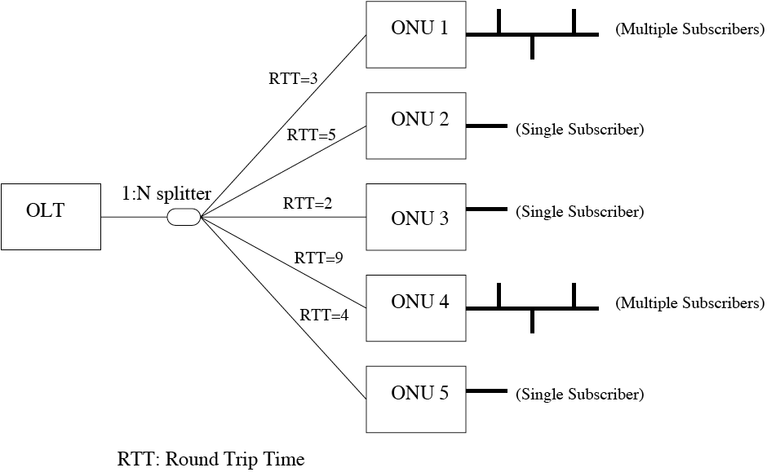
EPON
Architecture
  Typically, tree topology with optical line terminal (OLT) at tree root connected to multiple optical network units (ONUs) via optical splitter/combiner

Slide 7
EPON
Architecture
  Each ONU may serve
    Single residential or business subscriber (FTTH/FTTB)
    Or multiple subscribers (FTTC)
  Due to directional property of optical splitter/combiner
    Point-to-multipoint in downstream direction (OLT -> ONUs)
    Multipoint-to-point in upstream direction (ONUs -> OLT)
    ONUs cannot communicate directly with one another
  As a consequence, original Ethernet MAC protocol designed for broadcast medium cannot be applied in EPON
  Instead, EPON deploys a new access control protocol called multipoint control protocol (MPCP)

Slide 8
EPON
MPCP
  Objectives
    Avoid collision of upstream transmissions
    Increase upstream bandwidth utilization
  OLT best-suited to efficiently arbitrate upstream transmissions of ONUs by means of polling
  MPCP as EPON control plane has two operational modes
    Initialization
      Autodiscovery
      Registration
      Ranging
    Normal operation
      Coordination of upstream transmissions by facilitating dynamic bandwidth allocation (DBA)

Slide 9
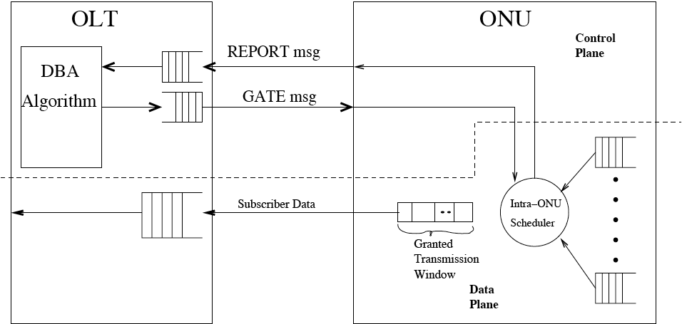
EPON
MPCP: Normal operation mode

Slide 10
EPON
REPORT & GATE messages
  REPORT
    Used by an ONU to report its bandwidth requirements (typically as queue occupancies) of up to eight possibly prioritized queues to OLT
    Upon reception, OLT passes REPORT to the DBA algorithm module for calculation of upstream transmission schedule
    NOTE: MPCP does not specify any particular DBA algorithm
  GATE
    After executing DBA algorithm, OLT transmits GATE down-stream to issue up to four transmission grants to ONU
    Each transmission grant contains
      Transmission start time
      Transmission length
      Timestamp (used by ONU for synchronization)
    ONU sends backlogged Ethernet frame(s) during its granted transmission window without frame fragmentation

Slide 11
EPON
Scheduling
  Generally, scheduling in EPON can be done in two ways
    Inter-ONU scheduling
      Arbitrates transmissions of different ONUs
    Intra-ONU scheduling
      Arbitrates transmissions of different priority queues in each ONU
  Two possible implementations
    Inter-ONU scheduling implemented at OLT & each ONU performs its own intra-ONU scheduling
    Both inter-ONU scheduling & intra-ONU scheduling implemented at OLT

Slide 12
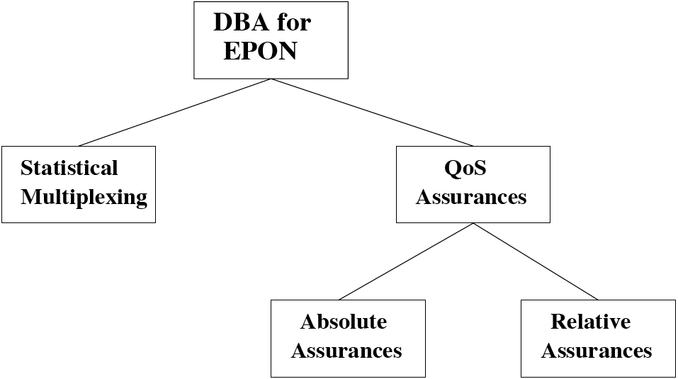
EPON
DBA algorithms
  A plethora of DBA algorithms has been proposed & studied
  Classification of DBA algorithms

Slide 13
EPON
DBA algorithms
  With statistical multiplexing
    Interleaved polling with adaptive cycle time (IPACT)
    Control theoretic extension of IPACT
  With absolute QoS assurances
    Bandwidth guaranteed polling (BGP)
    Deterministic effective bandwidth (DEB)
  With relative QoS assurances
    DBA for multimedia
    IPACT extension to multiple service classes
    DBA for QoS
  Decentralized DBA algorithms

Slide 14
EPON
IPACT
  OLT polls ONUs individually & issues transmission grants to them in round-robin fashion
  To mitigate walk times, OLT overlaps multiple polling requests in time => interleaved polling & higher utilization
  An ONU’s grant G(i) in polling cycle i is sized as follows
    First grant, G(1), is set to some arbitrary value
    In polling cycle n, ONU measures its backlog in bytes at end of current upstream data transmission & piggybacks the reported queue size, Q(n), at end of G(n)
    Q(n) used by OLT to determine next grant G(n+1) => adaptive cylce time & dynamic bandwidth allocation
    If Q(n)=0, OLT issues zero-byte grant to let ONU report its backlog for next grant
  To reduce overhead, in-band signaling of Q(n) done by using escape characters within Ethernet frames <=> MPCP uses separate Ethernet control frame (REPORT)

Slide 15
EPON
IPACT
  In general, each ONU’s service limited by maximum transmission window (MTW) => ONUs with high traffic volumes cannot monopolize bandwidth & throughput fairness
  DBA algorithms
    Fixed service
      OLT issues each ONU grant of size MTW => constant cycle time & static bandwidth allocation
    Limited service
      OLT grants requested number of bytes, but no more than MTW
    Credit service
      OLT grants requested number of bytes plus either constant credit or credit proportional to request
    Elastic service
      OLT grants an aggregate maximum of N MTWs to N ONUs, possibly allocating it to single backlogged ONU

Slide 16
EPON
IPACT
  Simulation results
    Under light traffic loads
      Limited, credit, and elastic service DBAs clearly outperform fixed service DBA in terms of average packet delay & average queue length
      Limited, credit, and elastic service DBAs provide similar performance
      Thus, dynamic bandwidth allocation superior to static bandwidth allocation
    Under heavy traffic loads
      All four DBAs perform similarly in terms of average packet delay & average queue length

Slide 17
EPON
Control theoretic extension of IPACT
  Drawback of IPACT
    Traffic arriving at an ONU between generation of Q(n) & arrival of G(n+1) is taken into consideration in next request message Q(n+1) => queueing delay of one cycle
  Control theoretic extension of IPACT
    Overcomes aforementioned queueing delay of one cycle by estimating & reporting traffic arriving between two requests
    Estimation
      Let A(n-1) denote traffic arriving to an ONU between generation of Q(n-1) & reception of G(n)
      Difference between G(n) & backlogged traffic at arrival of G(n) equals approximately D(n) = G(n) - [Q(n-1) + A(n-1)]
      Using gain factor α, OLT issues G(n+1) = G(n) - α · D(n), whereby α is carefully tuned to keep D(n) close to zero

Slide 18
EPON
Bandwidth guaranteed polling (BGP)
  BGP divides ONUs into two disjoint sets
    Bandwidth guaranteed ONUs
      Guaranteed bandwidth specified by service level agreement (SLA)
    Best-effort ONUs
  Upstream bandwidth is divided into equal bandwidth units such that number of bandwidth units > number of ONUs (e.g., 1 Gbps divided into 100 units of 10 Mbps for 64 ONUs)
  OLT maintains two tables
    Table for bandwidth guaranteed ONUs
      Number of entries = number of bandwidth units
    Table for best-effort ONUs
      Number of entries is not fixed

Slide 19
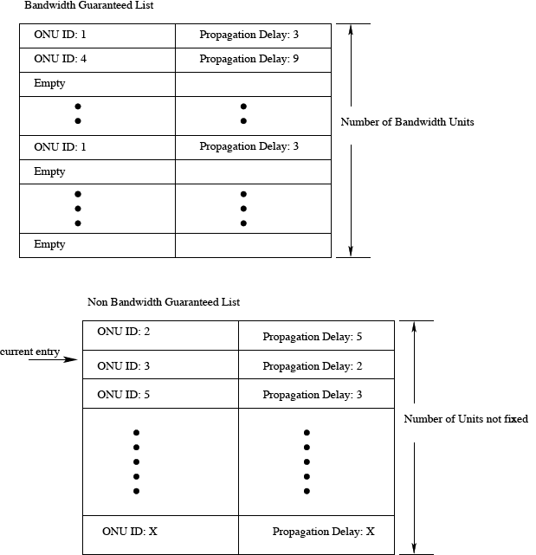
EPON
BGP
  Bandwidth guaranteed list
    Entry established for each bandwidth guaranteed ONU based on its SLA
    Entries spread evenly through table if ONU requires multiple band-width units
    Empty entries dynamic-ally assigned by OLT to best-effort ONUs
  Non bandwidth guaranteed list
  Both lists contain ONU IDs & propagation delays

Slide 20
EPON
BGP
  OLT polls all ONUs using the information of both tables
    OLT sends grant G of one bandwidth unit to an ONU
    ONU sends reply to OLT with window size B it intends to utilize & then transmits this amount of data
    OLT receives reply & checks B
      If 0 ≤ B ≤ G_{reuse}
        OLT polls next backlogged best-effort ONU & grants it transmission window G - B
      If B > G_{reuse}
        OLT does not poll next ONU until current grant has passed
      whereby G - G_{reuse} specifies minimum portion of
      bandwidth unit that can be shared

Slide 21
EPON
BGP
  Advantages
    Ensures that ONUs receive bandwidth specified by their SLAs
    Spacing between transmission grants has fixed bound
    Allows for statistical multiplexing of traffic into unreserved bandwidth units & unused portions of a guaranteed bandwidth unit
  Drawback
    Due to transmission grants of fixed bandwidth units, upstream transmission tends to become fragmented with each fragment requiring guard band => reduced throughput & decreased bandwidth utilization

Slide 22
EPON
Deterministic effective bandwidth (DEB)
  DEB admission control & resource allocation in conjunction with Generalized Processor Sharing (GPS) scheduling
  Each ONU maintains several queues, typically one for each traffic source or each class of traffic sources
  Queues categorized as either best-effort or QoS queues
  Leaky bucket parameters & delay limit used to admit traffic in QoS queues without violating delay bounds & dropping any ongoing QoS traffic
  OLT assigns grants to an ONU proportional to the ratio of aggregate effective bandwidth of ONU’s traffic to aggregate effective bandwidth of all ONUs’ traffic
  ONU serves each of its QoS queues in proportion to ratio of effective bandwidth of QoS queue to aggregate effective bandwidth of all its QoS queues
  ONU uses grants not utilized by QoS queues to serve best-effort queues

Slide 23
EPON
DEB
  Advantages
    Provides individual flows (or classes of flows) with deterministic QoS guarantees => lossless & bounded-delay service
    Best-effort traffic flows can utilize bandwidth not needed by QoS traffic flows
  Drawback
    Increased complexity & overhead to conduct admission control & update proportions of effective bandwidths of ongoing flows, especially for short-lived flows

Slide 24
EPON
DBA for multimedia
  Each ONU deploys three priority queues (high, medium, and low) & reports theirs sizes to OLT
  OLT performs both inter-ONU & intra-ONU scheduling using strict priority
    First, bandwidth assigned to ONUs’ high-priority queues, satisfying all high-priority flow requests
    Second, all medium-priority flow requests are satisfied with what is left over from high-priority requests if there is sufficient remaining bandwidth
    Otherwise, each medium-priority flow request is assigned bandwidth related to fraction of request and total of all medium-priority flow requests
    Finally, any leftover bandwidth is distributed among low-priority flows
  Strict priority scheduling may result in starvation of ONUs with only low-priority traffic

Slide 25
EPON
IPACT extension to multiple service classes
  Differentiated service to three classes of traffic with strict priority scheduling inside ONU (instead of OLT)
  Light-load penalty
    Under light loading, significantly increased average packet delay for lower-priority traffic & maximum packet delay for higher-priority traffic
    This is due to fact that higher-priority traffic arriving after queue reporting but before transmission grant is allowed to preempt lower-priority traffic that arrived before reporting
  Solutions
    Scheduling packets when report message is sent & placing them in a second stage queue that will be emptied out first after receiving grant message
    Predicting number of high-priority packets arriving between report and grant messages

Slide 26
EPON
DBA for QoS
  Each ONU performs priority queueing per DiffServ framework
  ONU deploys priority scheduling only on packets arriving before t_{request} (time when REPORT is sent to OLT) => lower-priority queues cannot be starved by higher-priority traffic arriving after t_{request}
  Upstream bandwidth B_{total} divided among ONUs in proportion to their SLAs
    ONU i is assigned guaranteed bandwidth B_{i} = B_{total} · w_{i}
    Weighing factor w_{i} is set in proportion to SLA of ONU i, whereby ∑_{i} = 1
  OLT pools together excess bandwidth from lightly loaded ONUs & distributes it to highly loaded ONUs in proportion to their requests
  Optionally, ONUs may deploy one-step prediction of high-priority traffic arriving between t_{request} and t_{grant}

Slide 27
EPON
Decentralized DBA algorithms
  All aforementioned DBA algorithms are centralized schemes where OLT acts as central control unit performing inter-ONU and/or intra-ONU scheduling
  Alternatively, decentralized DBA algorithms & distributed scheduling can be done at the expense of modifying original EPON architecture
    Remote node must be modified such that each ONU’s upstream transmission is echoed to all ONUs
    Each ONU must be equipped with additional receiver to receive echoed transmissions
  In decentralized DBA algorithms, both inter-ONU and intra-ONU scheduling done by ONUs without OLT, achieving high bandwidth utilization

